Slide 1
類神經期中報告
M10715809 CHOI HYUNMIN
M10715812 張天佑

Slide 2
Data介紹
我們最直接的作法就是將這些data全部merge在一起
那麼在考慮這些問題的時候，會對data做清洗動作。
比如 座標點的處理，plan的處理。
train_query行數不一樣，所以我們需要對null部分以0填充。
Mode 部分自然會被當成label

Slide 3
Data處理
座標以及plan處理，我們會將多餘的符號去除。例如：distance 字符全部clear。
初期階段我們打算feed所有feature，那在數據處理中，我們會考慮全部丟進去。
那麼後期我們會將不太重要的data去除，再用相同的data 丟進不同的model訓練。

Slide 4
工作環境
Jupyter
Python
Pytorch & keras
sklearn

Slide 5
初期嘗試
經過初期簡單的data處理，我們得到的結果。
nn得到的結果只有0.3，randomforest得到結果最好為0.67
所以在後面的數據處理中，會在randomforest中進行更多數據處理。
1 | ann | 0.36951434
2 | knn | 0.51807312
3 | randomforest | 0.67105452

Slide 6
Mastering the game of Go with deep neural networks and tree search
M10715809 CHOI HYUNMIN
M10715812 張天佑

Slide 7
abstract
A new approach with ‘value’ and ‘policy’ networks trained by a novel combination of supervised and reinforcement learning
Simulate random games with Monte Varlo tree search without any lookahead search
Good results the AlphaGo achieved

Slide 8
The problem with tranditional method
An optimal value function of perfect information is infeasible with exhaustive search
Two general principles:
Reduce depth of the search by position evaluation
Reduce breadth by smapling actions from a probability distribution

Slide 9
Monte Carlo tree search(MCTS)
As more simulations executed, the search tree grows larger and the relevant values become more accurate
Policy is also improved over time
Hightest value subtree will be chosed and allowed to expansion

Slide 10
Monte Carlo tree search(MCTS)

Slide 11
MCTS in Go game

Slide 12
Supervised learning of policy networks
prior work has been limited to shallow policies or value functions based on a linear combination of input features
propose a CNN architecture to solve the problem of turning linear into nonlinear
pass in the board position as a 19 × 19 image and use convolutional layers to construct a representation of the position
The advantage of doing this is that we use these neural to reduce the effective depth and breadth of the search tree

Slide 13
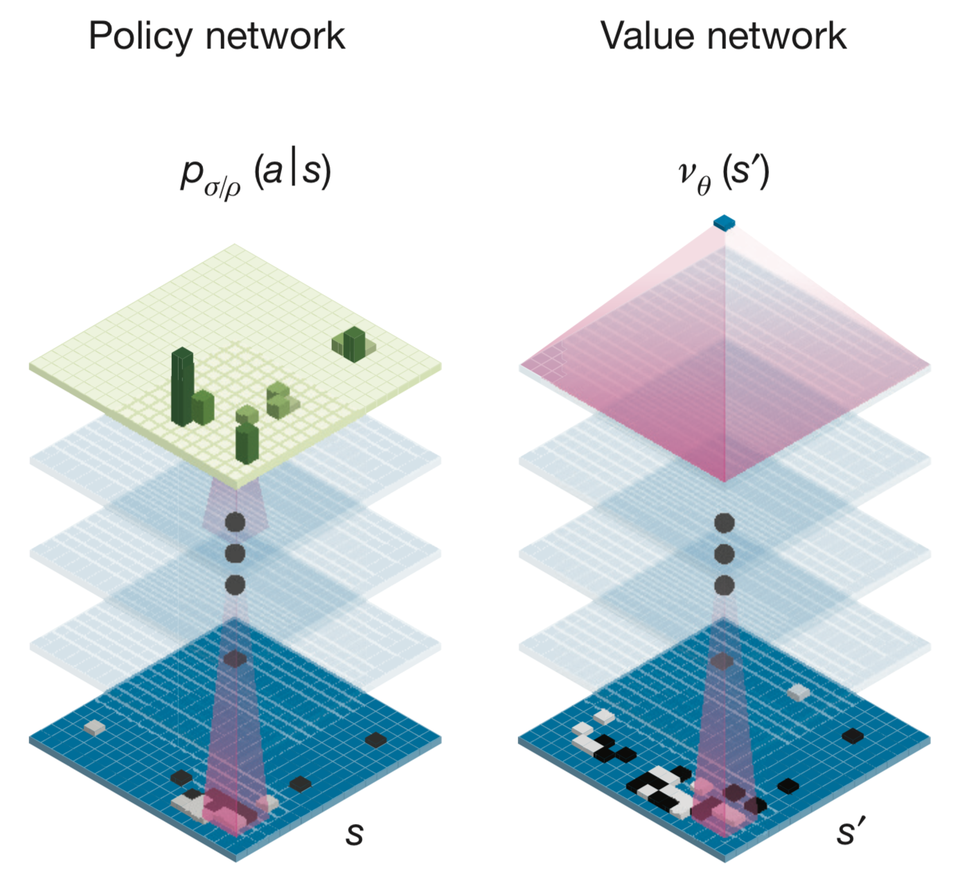
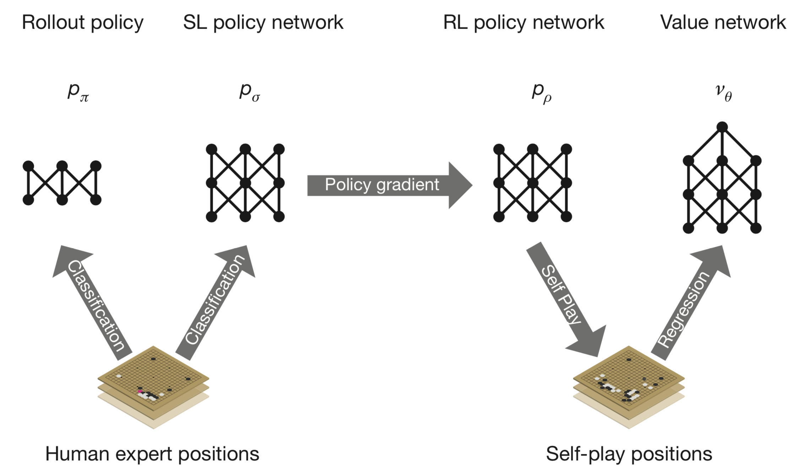
Supervised learning of policy networks
evaluating positions using a value network, and sampling actions using a policy network

Slide 14
Reinforcement learning of policy networks
We trained a 13-layer policy network, which we call the SL policy network, from 30 million positions from the KGS Go Server

Slide 15
Reinforcement learning of value networks

Slide 16
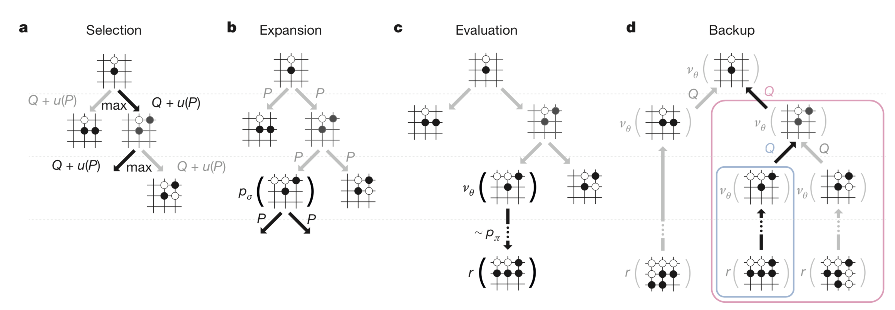
Searching with policy and value networks

Slide 17
Evaluating the playing strength of AlphaGo

Slide 18
Discussion
a Go program, based on a combina- tion of deep neural networks and tree search

